Slide 1


SWRO DESALINATION and VRF SYSTEMS
DESIGN FOR A COASTAL HOTEL
Presented by :
  Abdelrahman Ahmed Mosa Abd Elgawad
  Ahmed Adel Youssef Selim
  Amr El Sakar
Supervised by : Dr. Mohamed Shawky

Slide 2
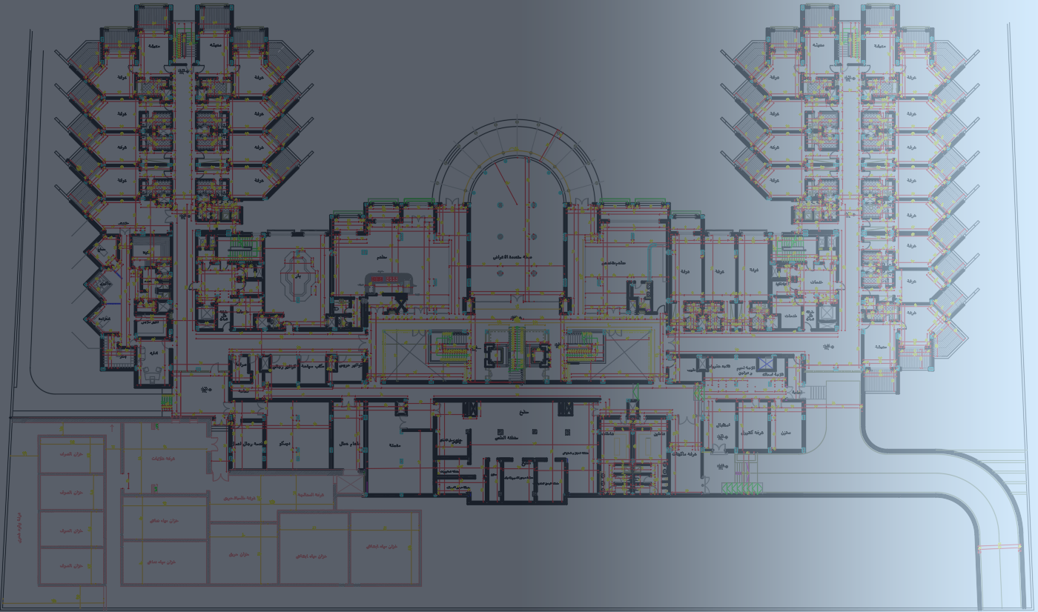
SWRO DESALINATION SYSTEM

Slide 3
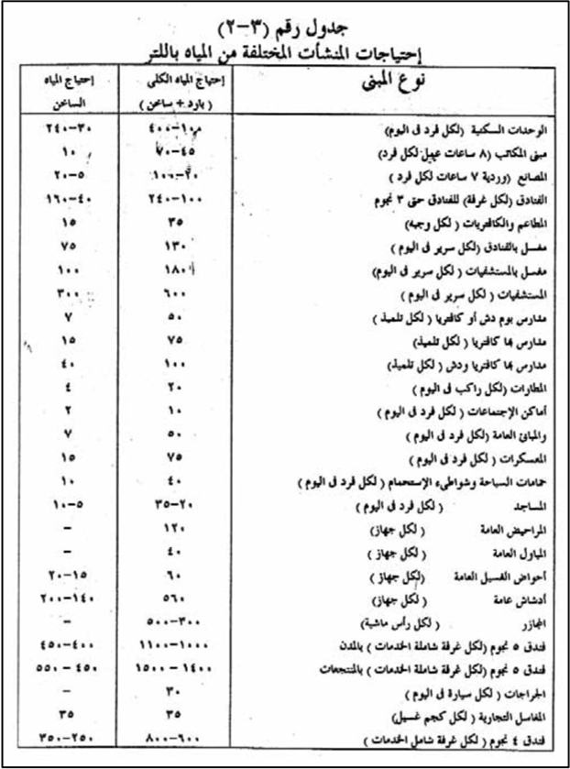
Hotel Demand
The hotel has 118 rooms
1 m³/room per day
Hotel Demand = 118 m³/day.
Hotel Demand * fos = 141.6 m³/day.

Slide 4
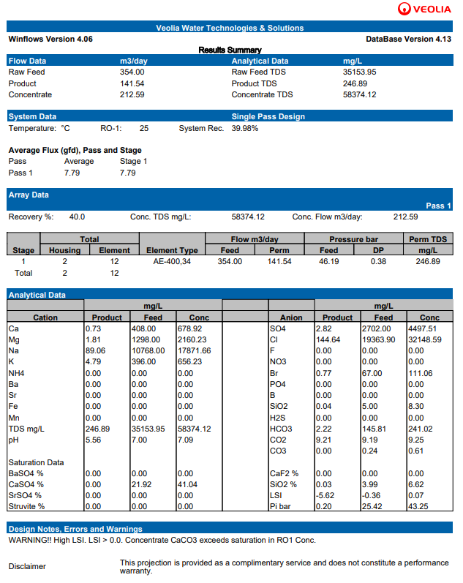
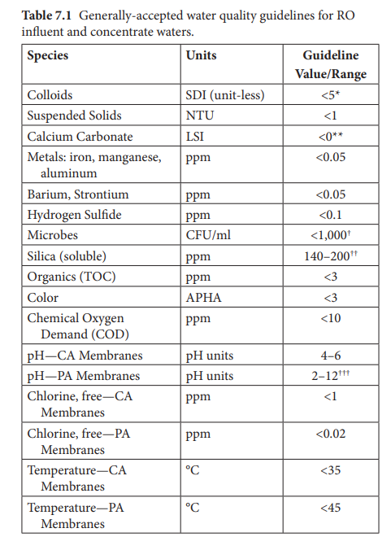
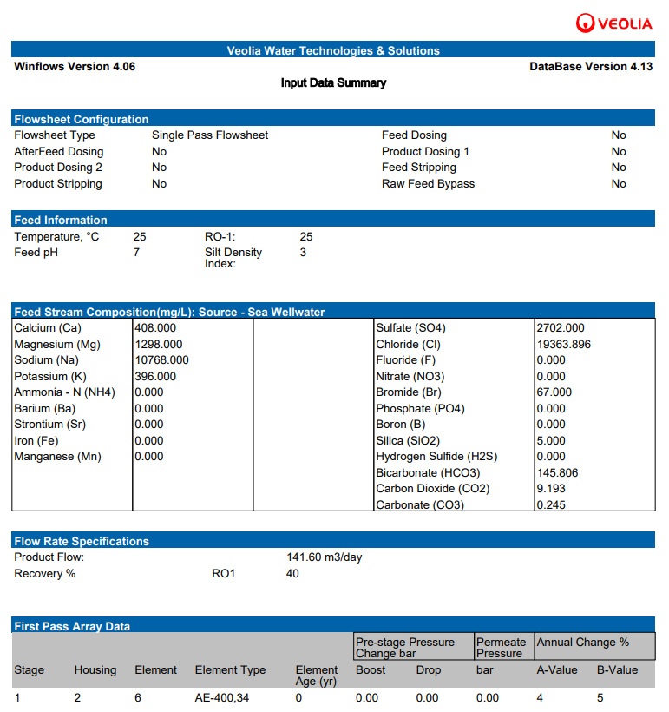
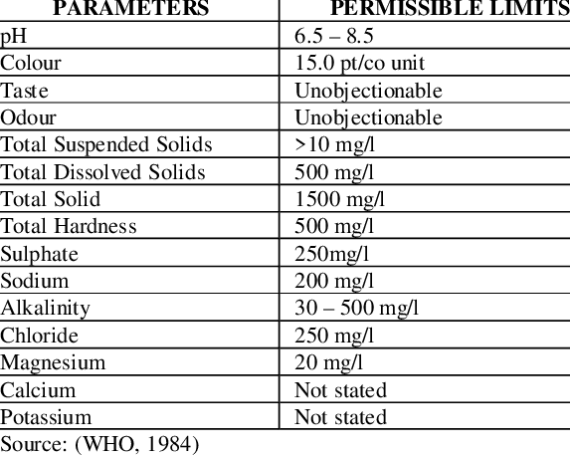
VEOLIA Winflows Analysis
Drinking Water Quality Guidelines
Analysis Input Data
RO Feed Quality Guidelines
Analysis Results for Feed, Brine, and Permeate Water

Slide 5
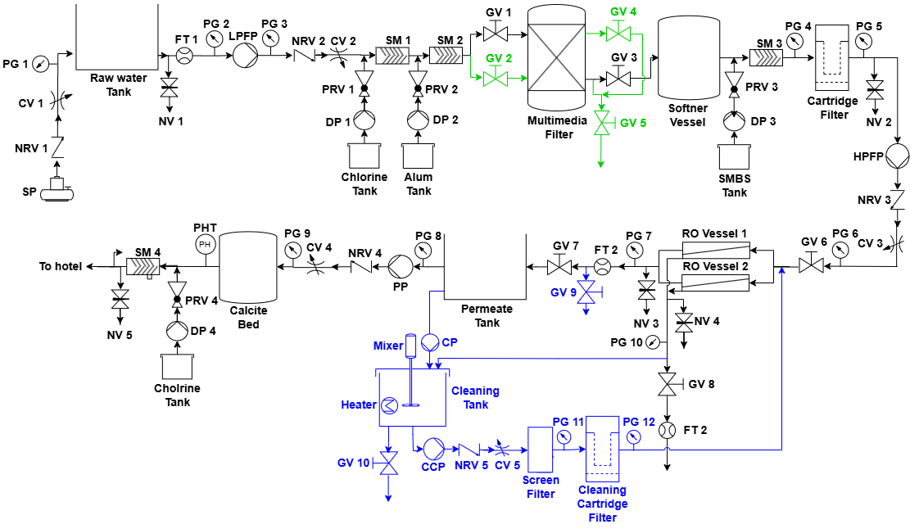
Pre-Treatment

Slide 6

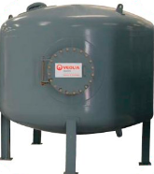

Procedure
Chlorination
Coagulation
Multimedia Filtration
VEOLIA FIB-125

Slide 7
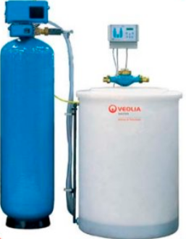
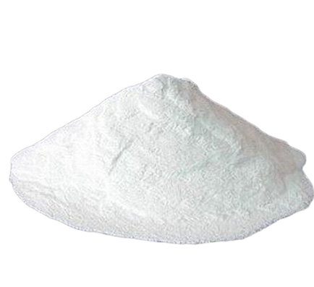
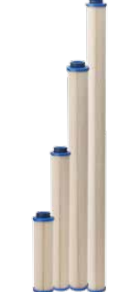
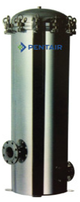
Procedure
Softener
SMBS
Cartridge Filter
VEOLIA AZ350
PENTAIR housing CFHF filters

Slide 8
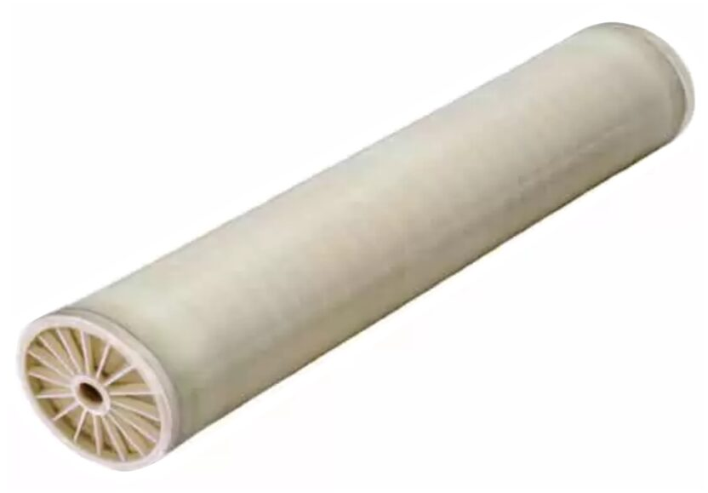

Membrane (Core)
40% Design Recovery Rate within 35~50 Range
Product Flow Rate 141.6 m³/day
Flux 9.2 GFD within 8~12 Range
TDS Reduced from 35,153.95 to 246.89 mg/L
2x6 VEOLIA AE-400-34 Membranes
$$N_{E}=\frac{Q_{P}}{f S_{E}}$$

Slide 9
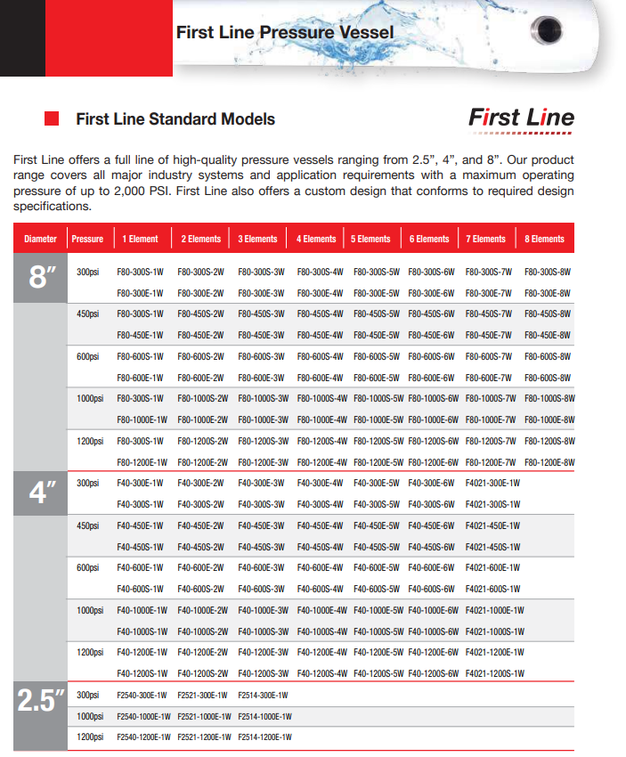
Pressure Vessels
670 psi Inside Pressure
7.9 Inches Element Diameter
2 Pressure Vessels
SNOWATE F80-1000E-6W

Slide 10
Post-Treatment

Slide 11
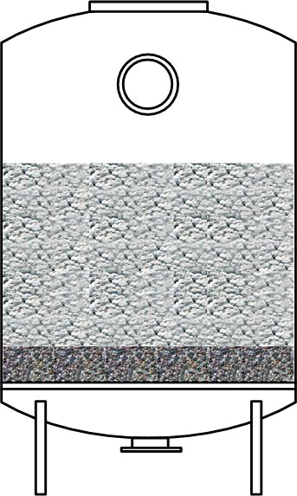
Procedure
Chlorination
Remineralization
LENNTECH Calcite Filtration Media

Slide 12
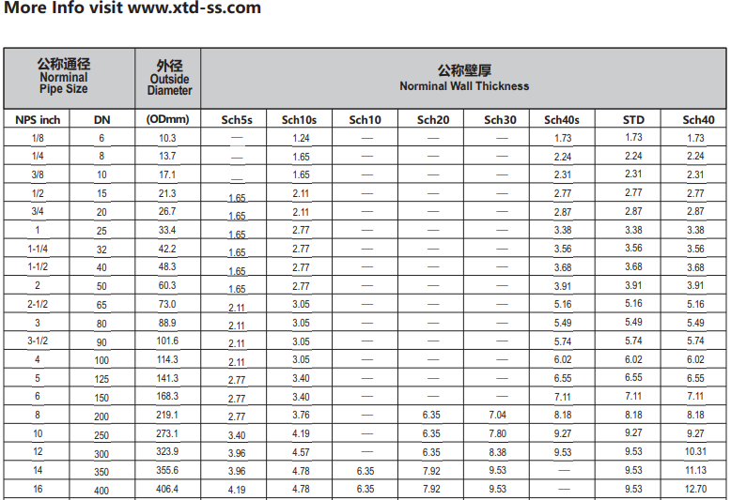
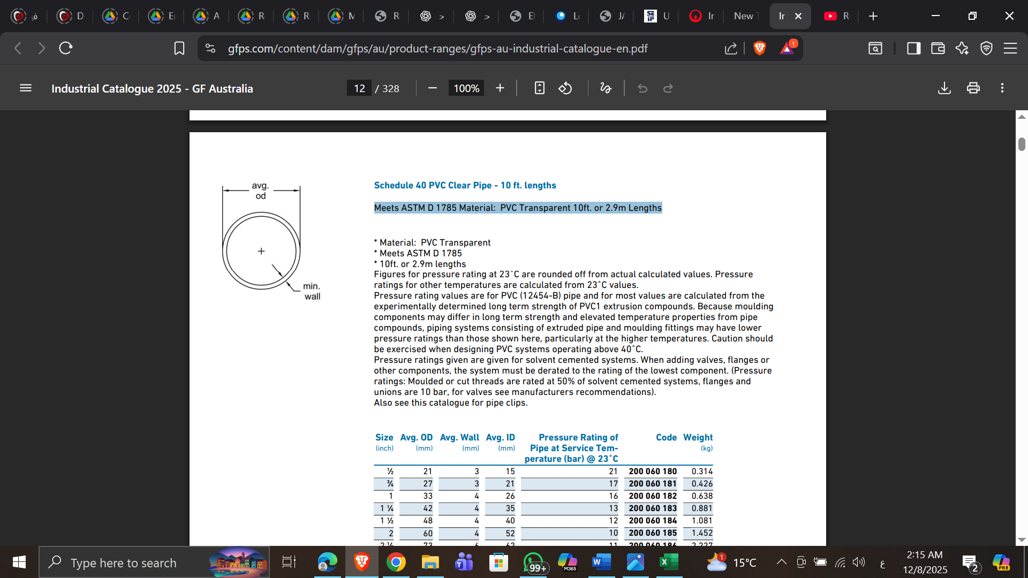
Pipe Sizing
Low Pressure
High Pressure

Slide 13
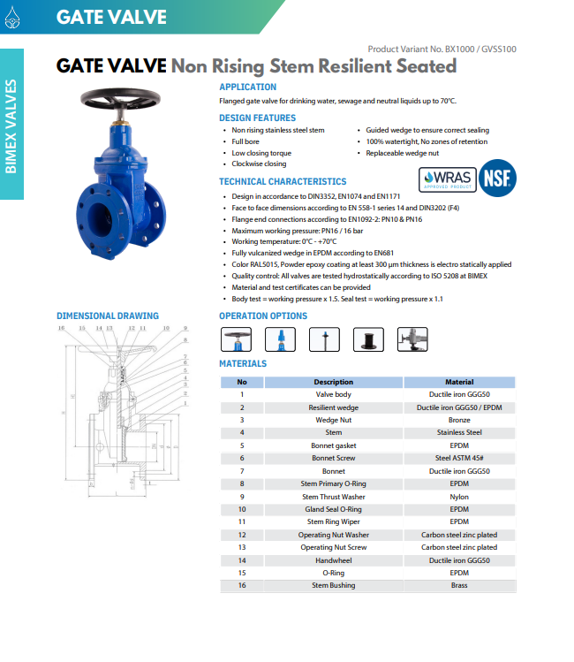
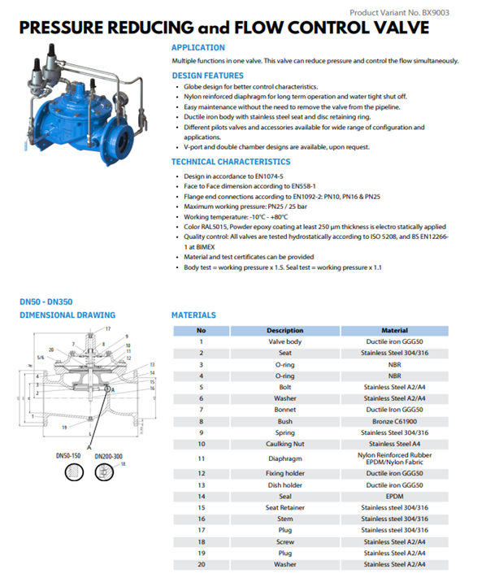
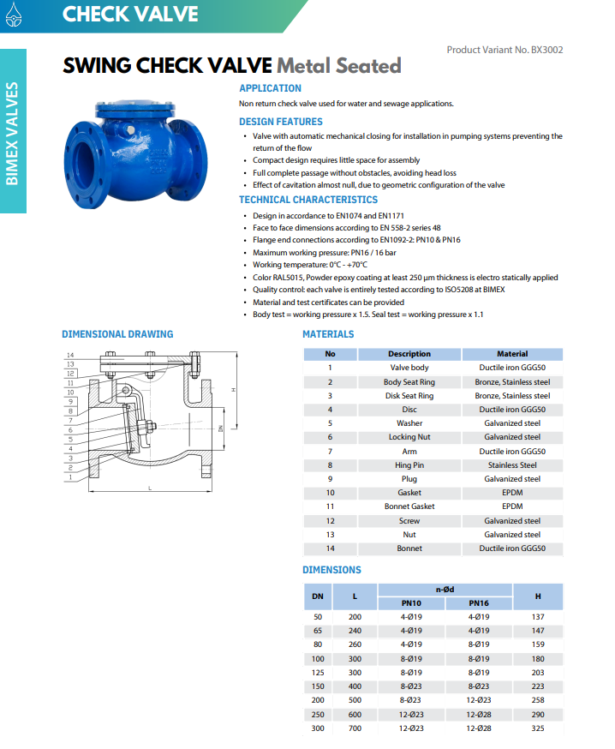
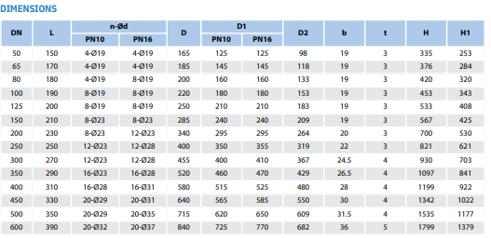
Valves
Check Valve
Isolation Valve
Flow Control Valve

Slide 14
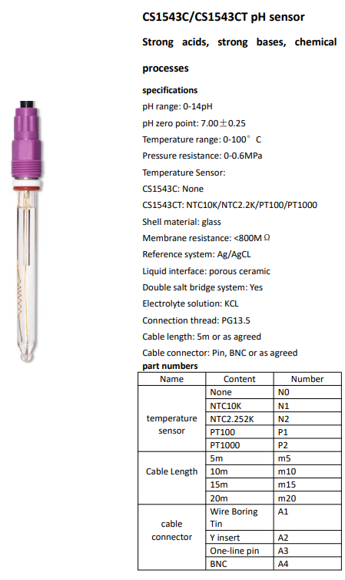
Measuring Devices
Pressure Gauge
Flow Meter
PH Meter

Slide 15
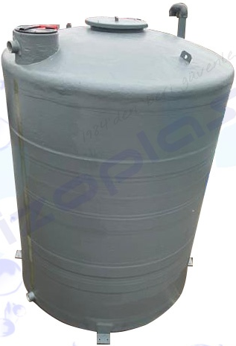
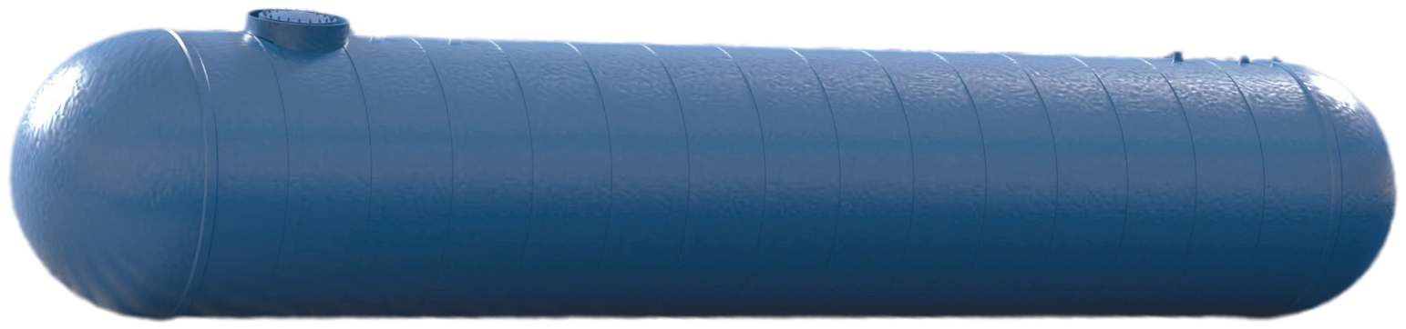
Tanks
Underground Permeate Storage Tank
Nationwide Gen2 Underground Fiberglass Tank
Raw Water Tank
IZOPLAS Vertical Fiberglass Tank

Slide 16
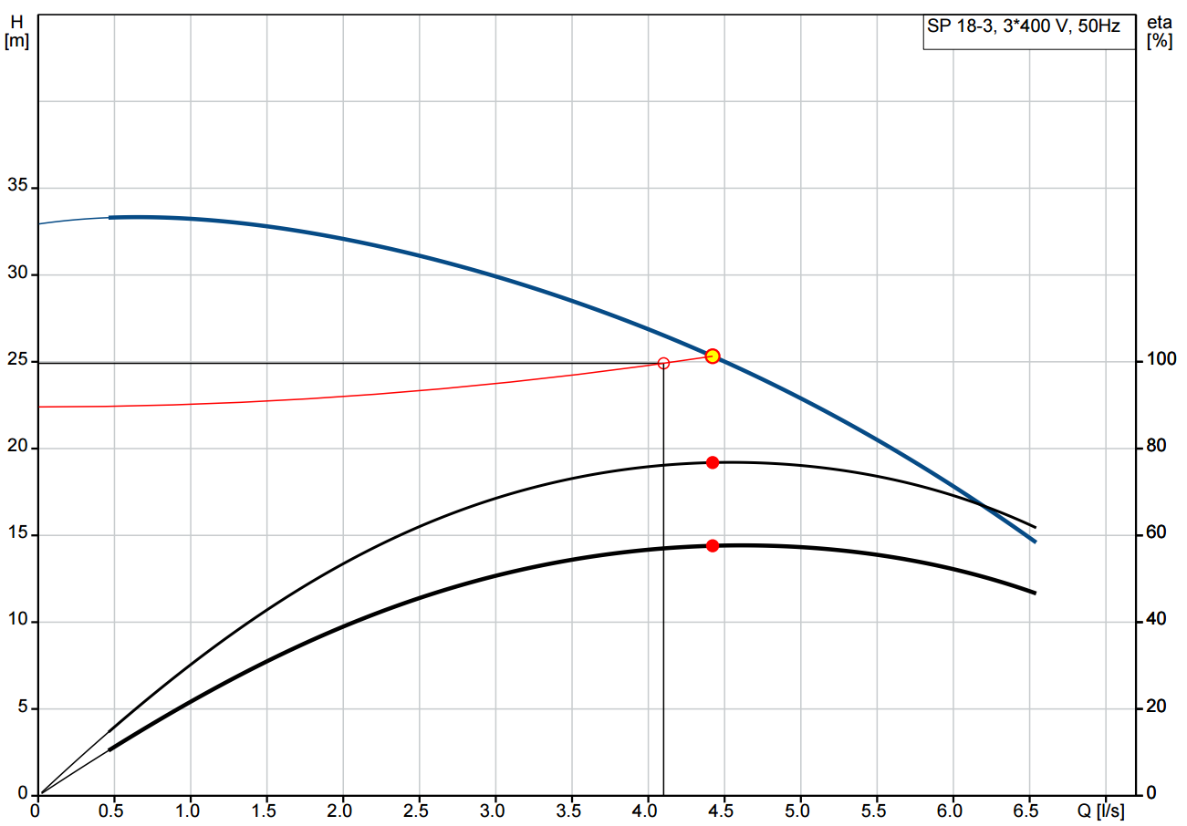
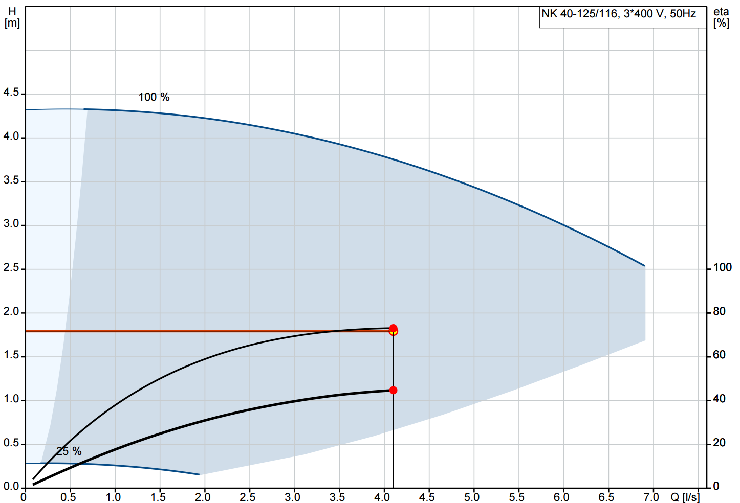
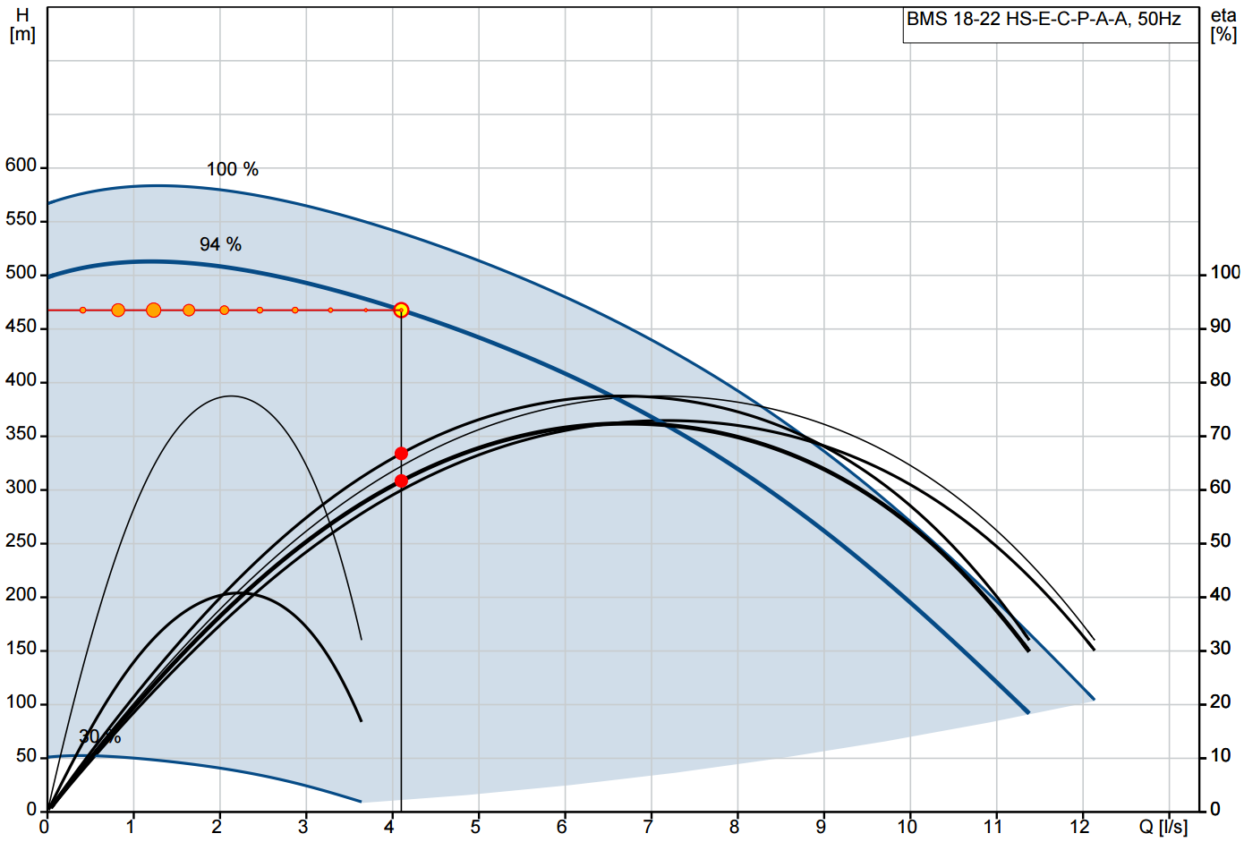
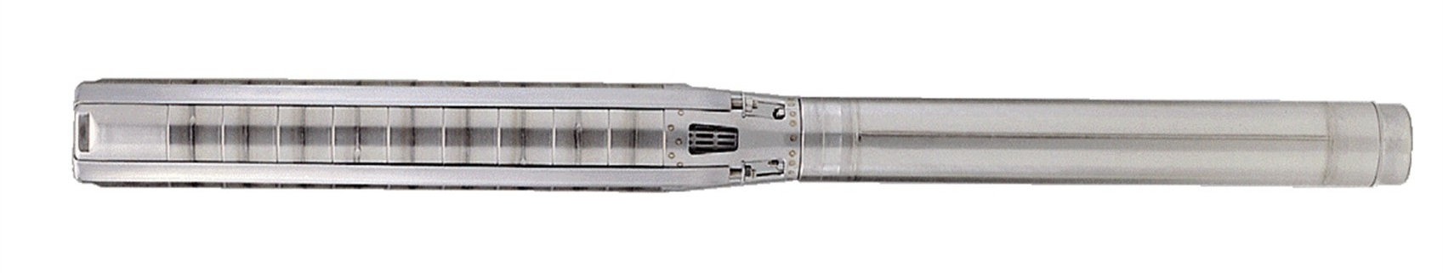
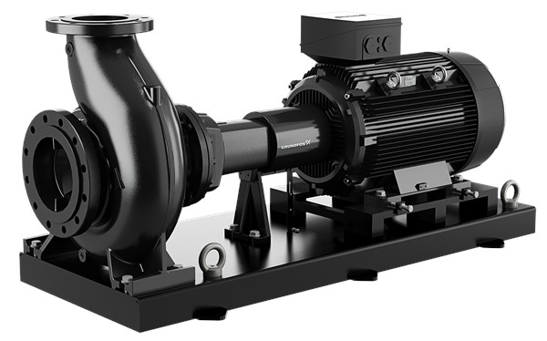
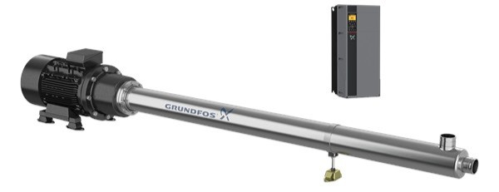
Pumps
Q = 4.4 L/s
H = 25.3 m
Q = 4.2 L/s
H = 2.2 m
Q = 4.11 L/s
H = 468.7 m
GRUNDFOS SP 18-3
GRUNDFOS NK 40-125116
GRUNDFOS BMS 18-22
Well Submersible Pump
Low Pressure Feed Pump
High Pressure Feed Pump

Slide 17
Electricity Cost Analysis
Power Demand
39.07 kW
Energy Consumption
937.79 kWh/day
Fresh Water Output
141.6 m³/day
Local Operating Cost
14.737 LE/m³
Global Operating Cost
1.053 USD/m³

Slide 18
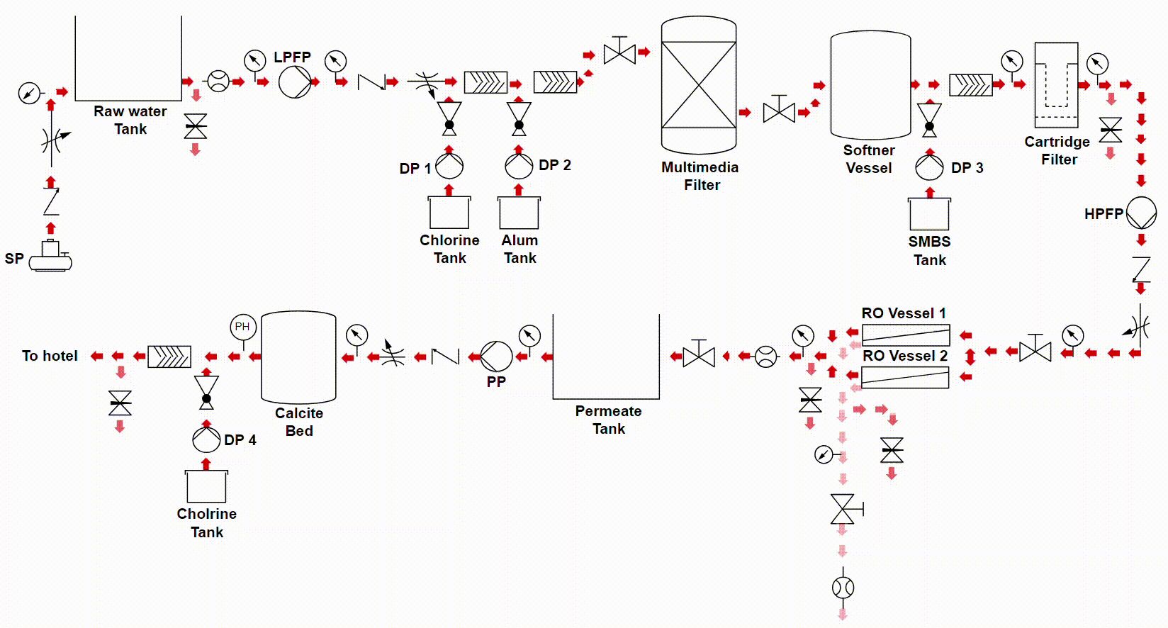
Normal Operation

Slide 19
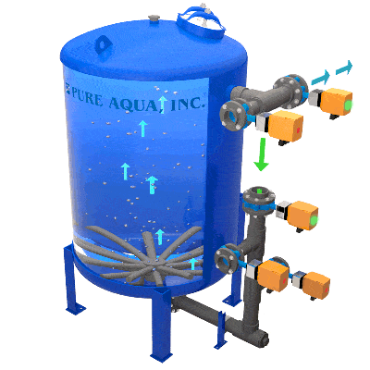
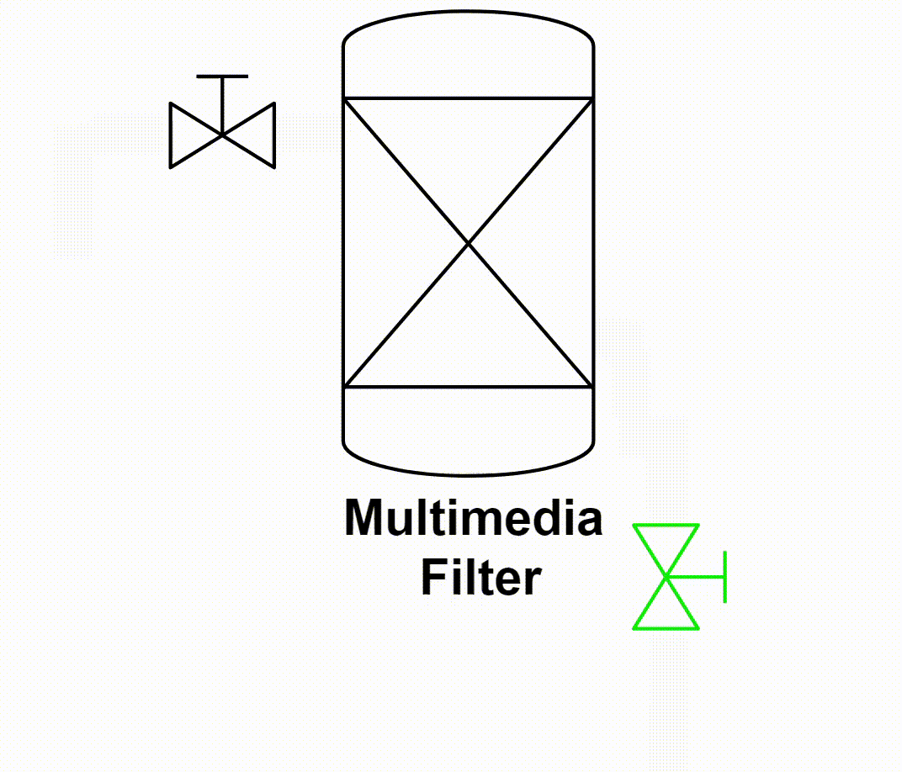
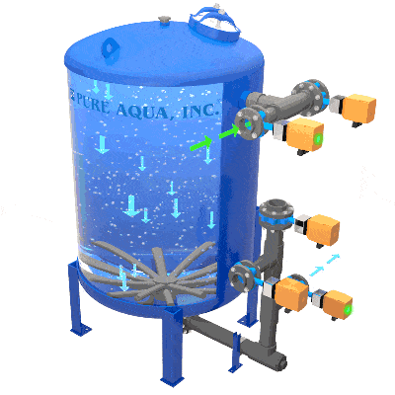
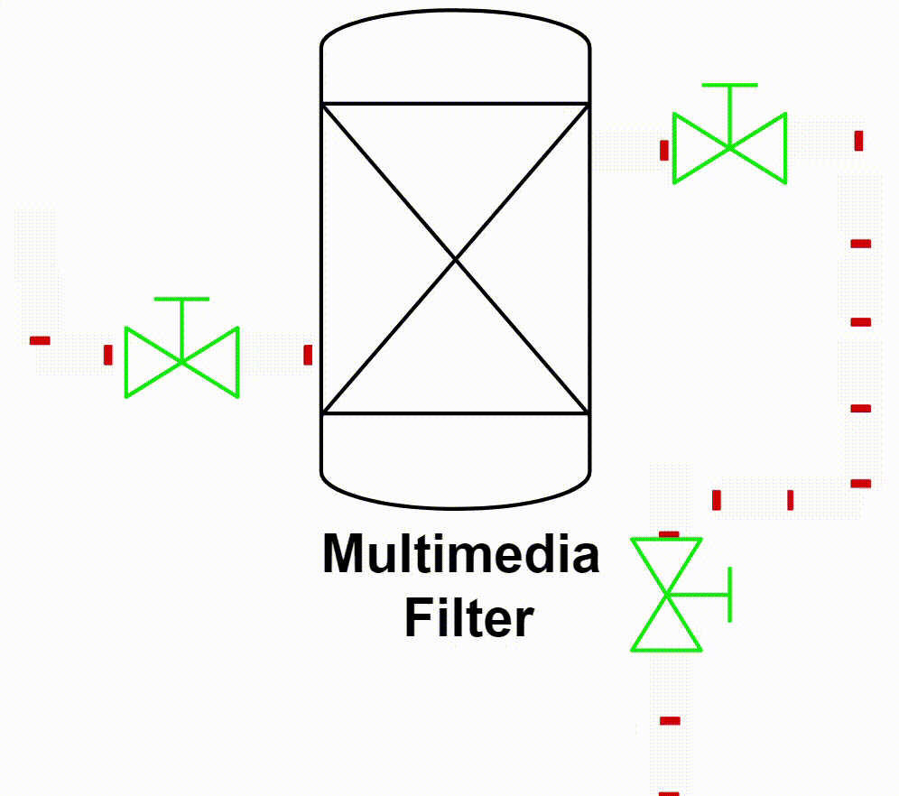
Backwash
Backwash Cycle
Rinse Cycle

Slide 20
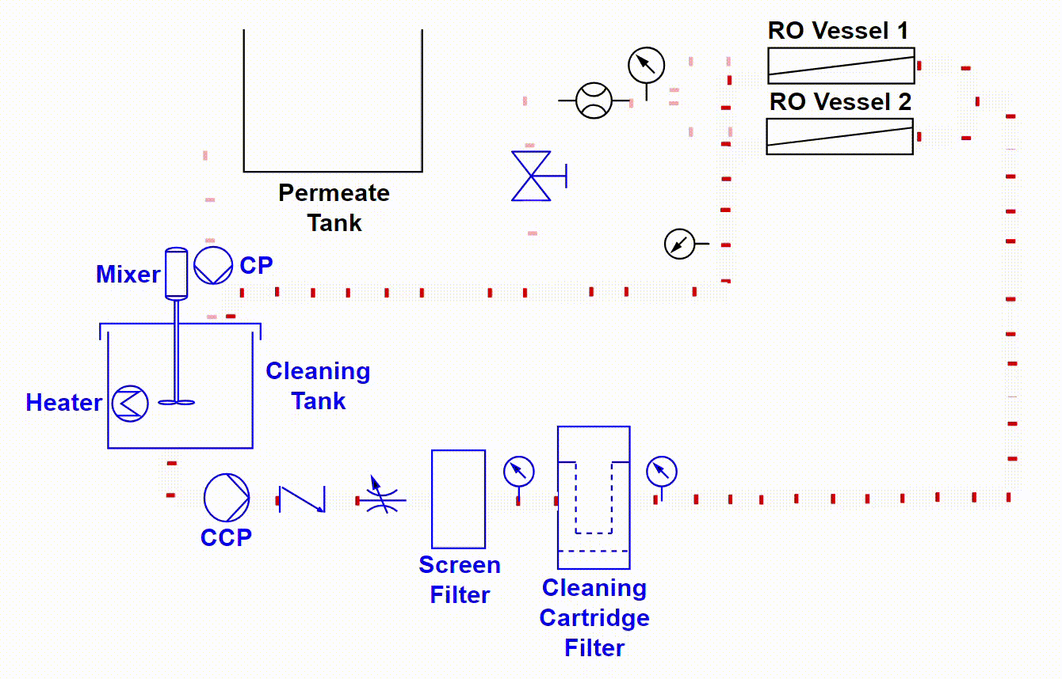
Cleaning

Slide 21
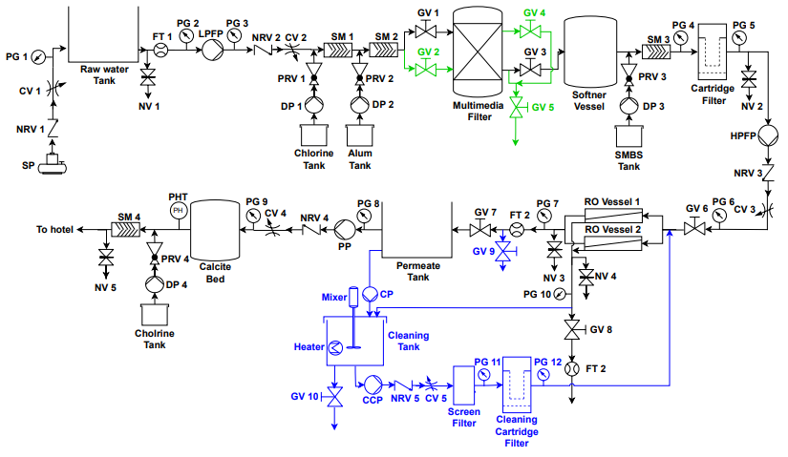
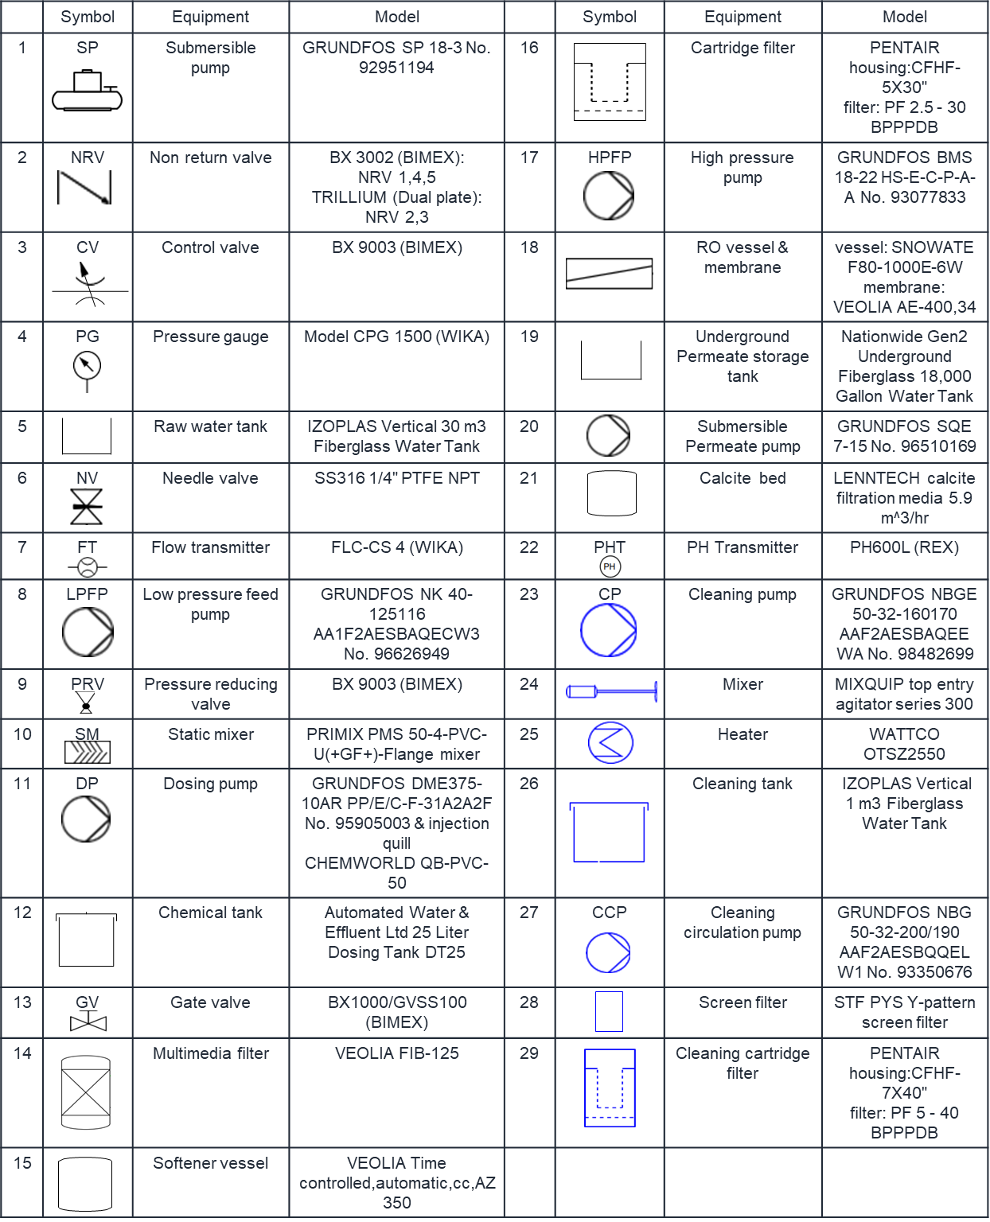
Plant P&ID
Normal Operation
Backwash
Cleaning

Slide 22
VRF SYSTEM

Slide 23
Load Estimation

Slide 24
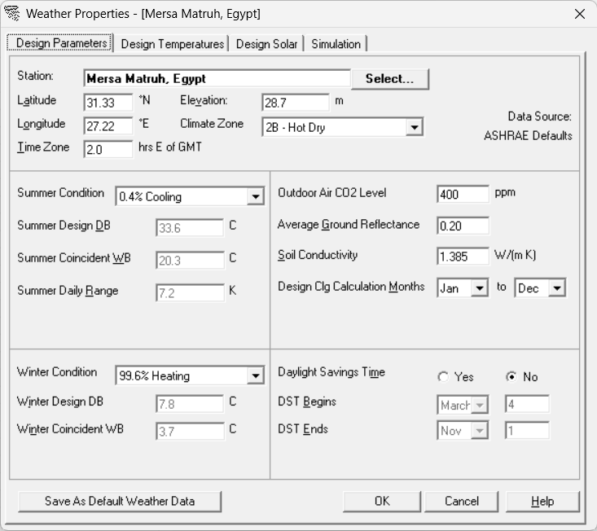
Carrier HAP
Weather
Properties

Slide 25
Carrier HAP
Architectural
Configurations

Slide 26
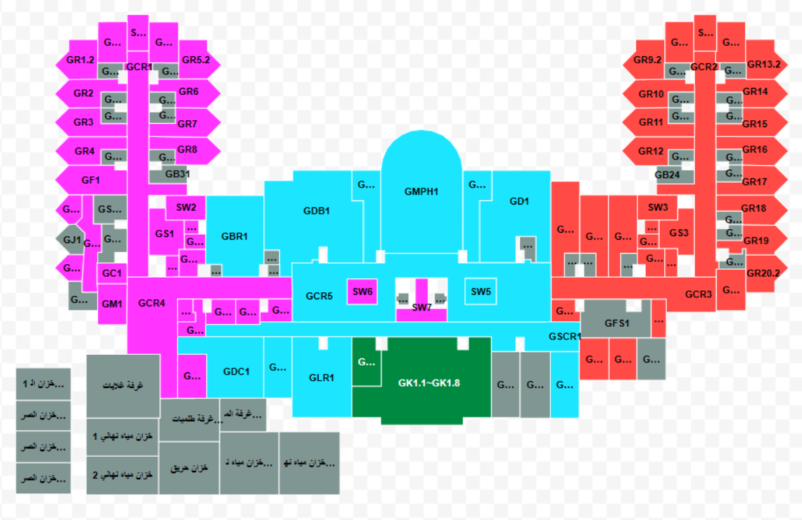
Carrier HAP
East
Mid
West
Kitchen
Unconditioned

Slide 27
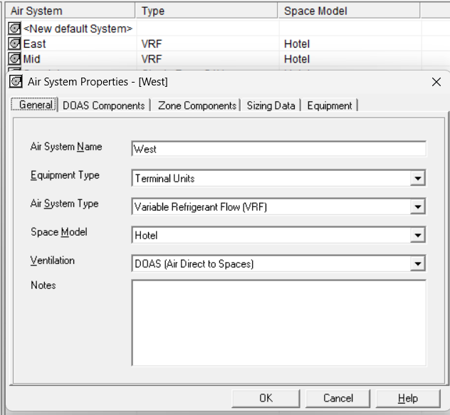
Carrier HAP
Air Systems

Slide 28
Load Design Results Sample

Slide 29
System Design
VRF
~0% FAR
DOAS
100% FAR
+

Slide 30
Components Selection

Slide 31
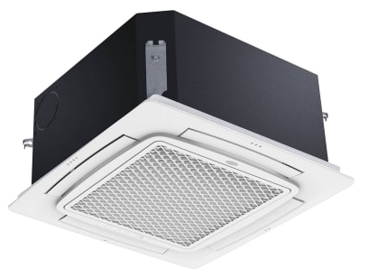
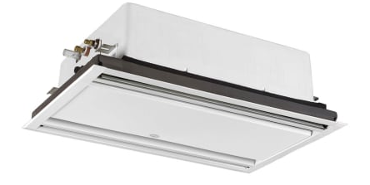
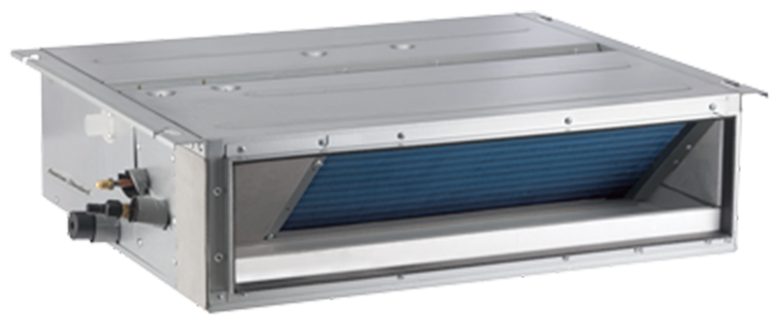
VRF Indoor Units
Four Way Cassette
Two Way Cassette
Concealed Duct Unit

Slide 32
VRF Indoor Units

Slide 33
VRF Outdoor Units

Slide 34
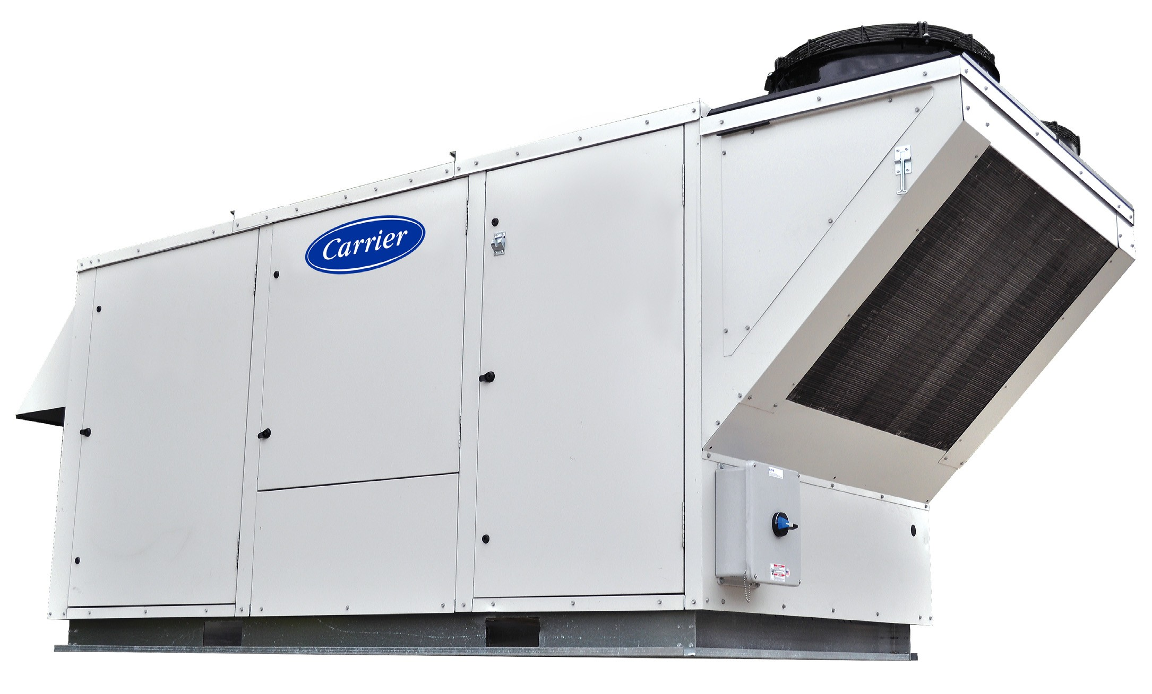
DOAS

Slide 35
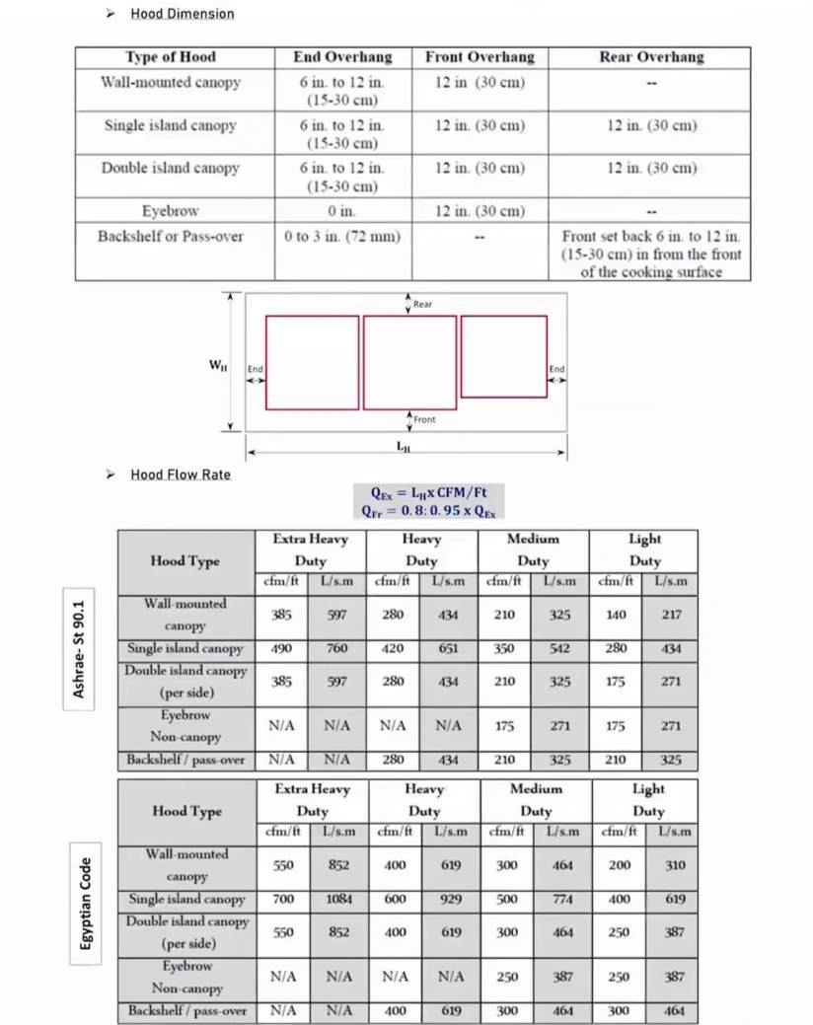
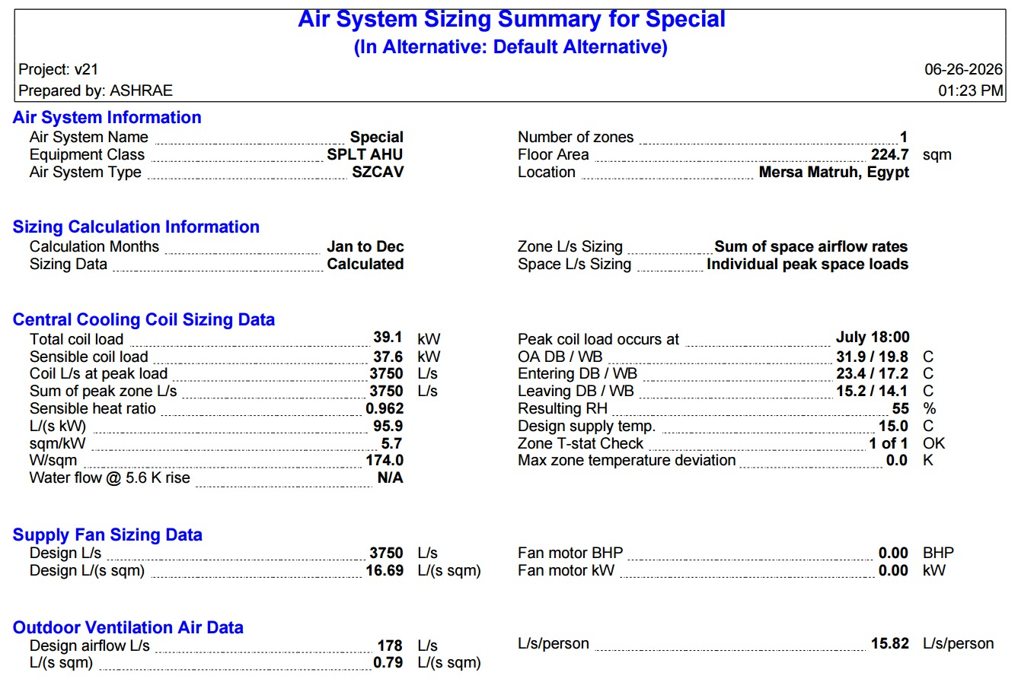
Kitchen Zone
Double
Island
Canopy

Slide 36
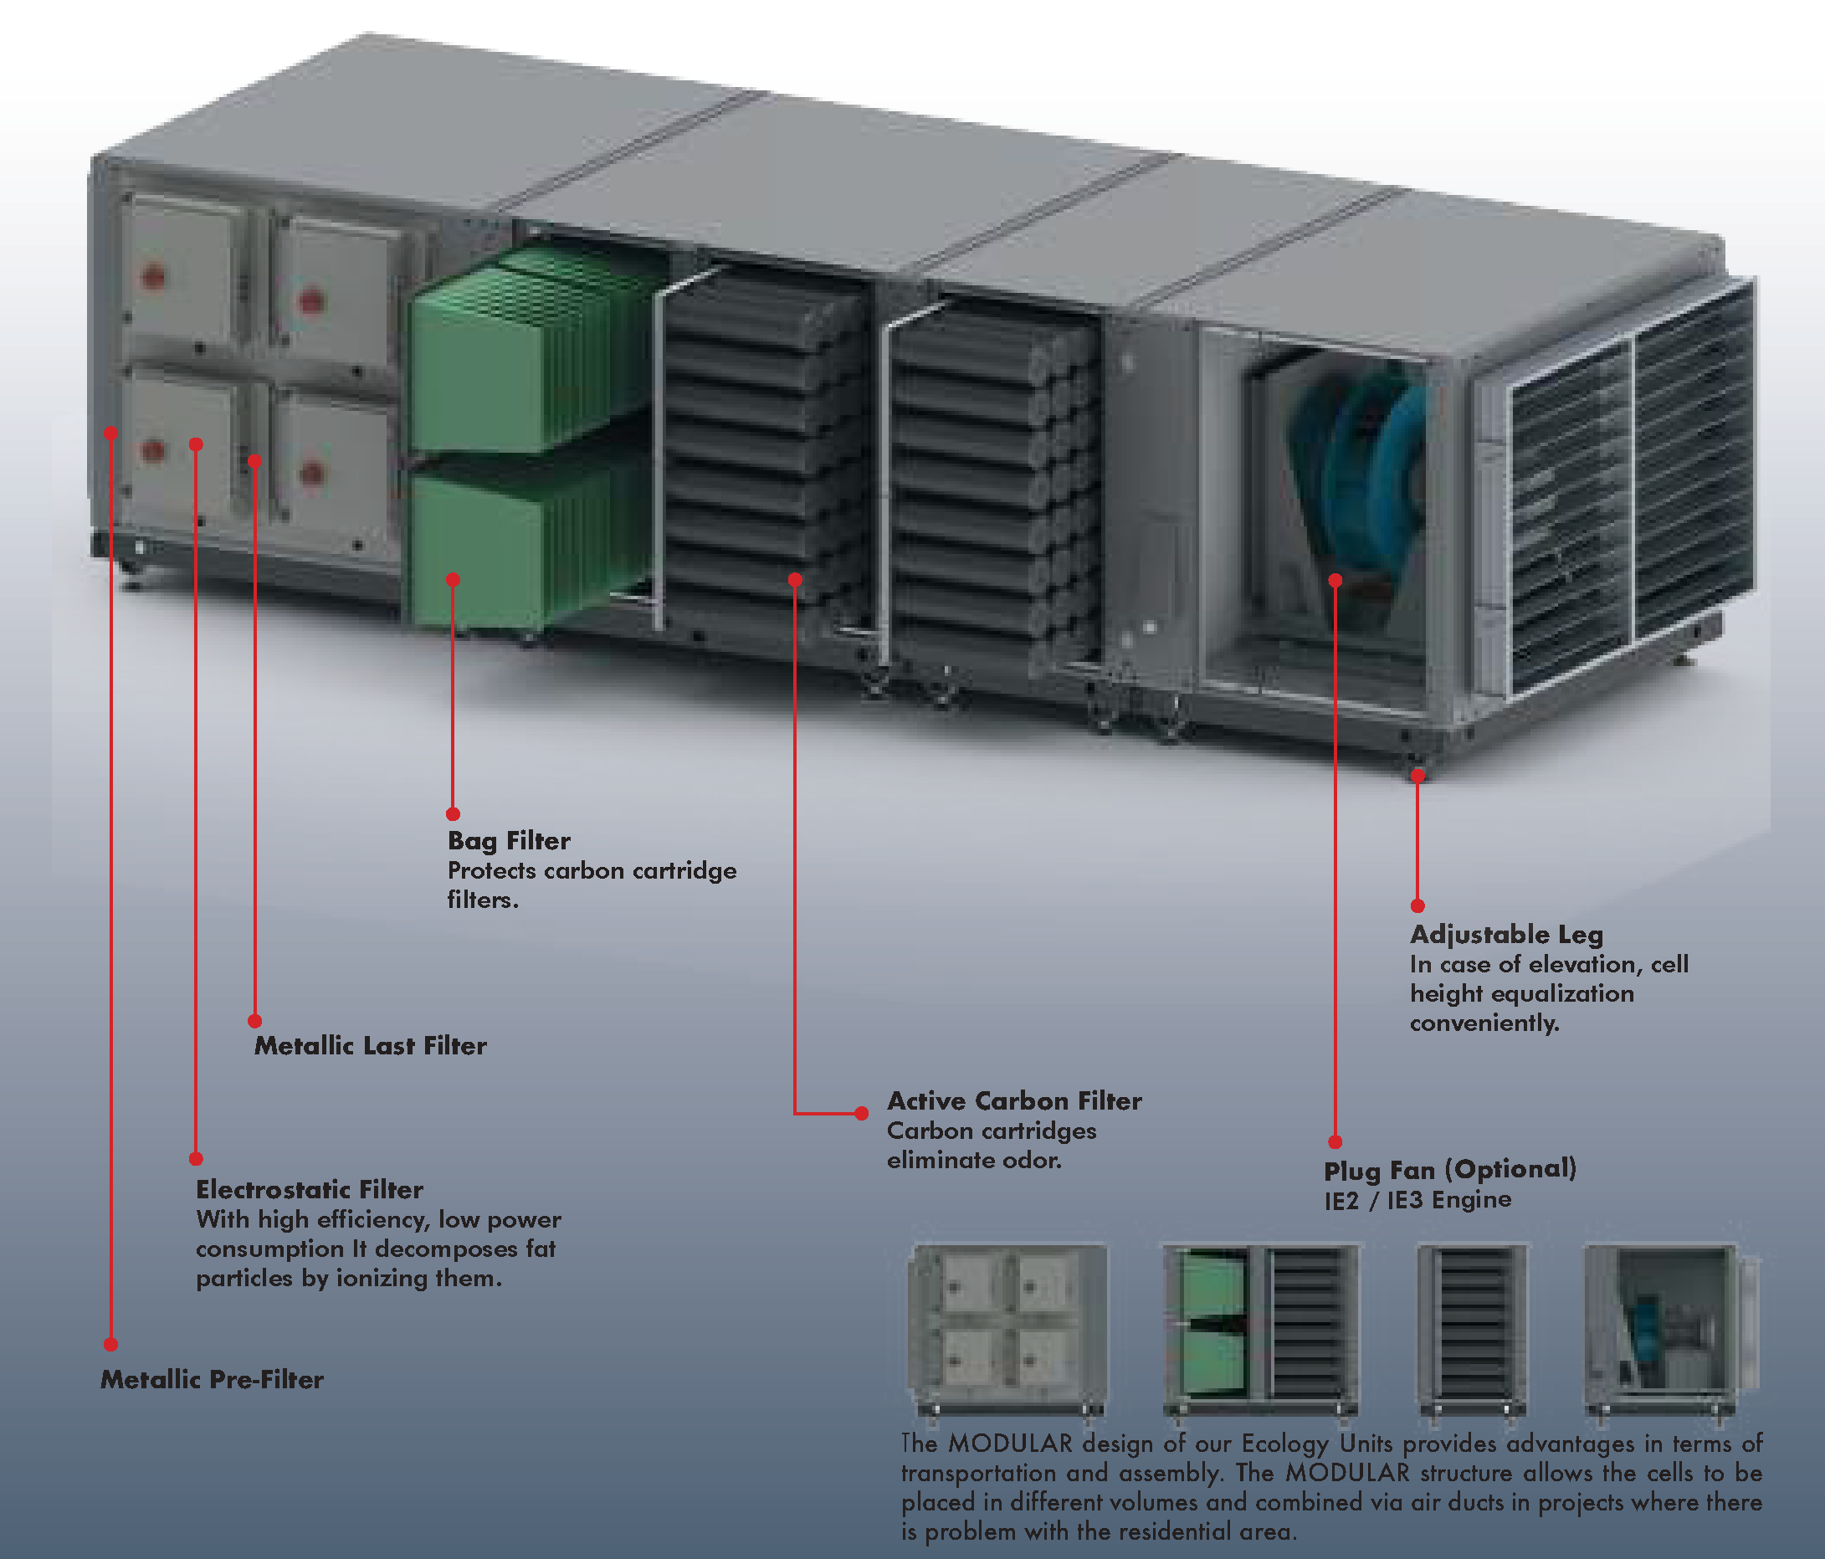
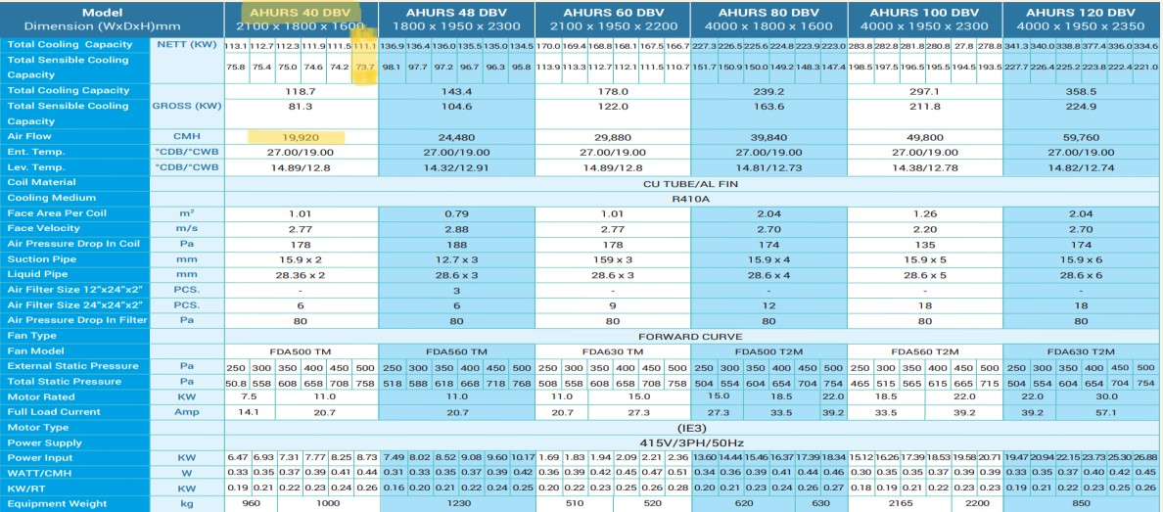
DX-AHU

Slide 37


Duct Sizing

Slide 38


ESP and Fan Selection
West-Side Fan
East-Side Fan

Slide 39

Shop drawing

Slide 40

THANK YOU!

